Slide 1
Introduction to ConvNet and Tensorflow
Presenter : Muhammad Faiz Misman

Slide 2
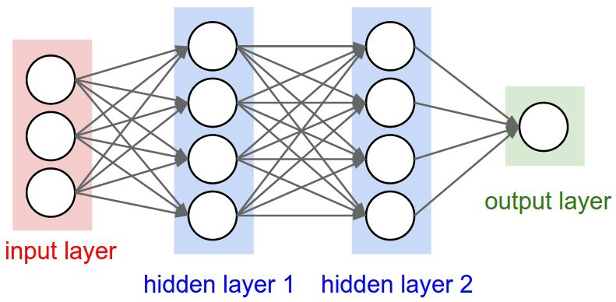
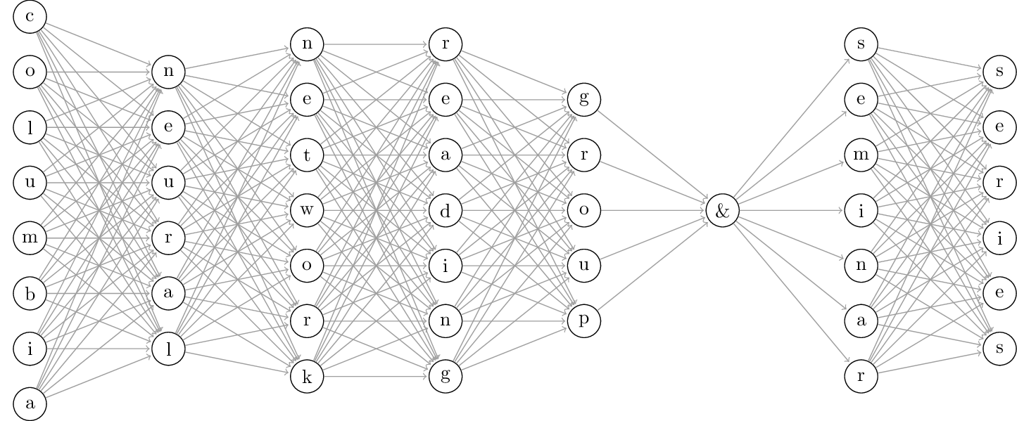
What is Deep learning
Shallow network
Deeper network
First deep learning architecture was introduced in2006 by G.Hinton et al, they call ‘Deep belief network’
Become more popular when Nvidia introduced CUDA for parallel processing using GPU
Becoming hot topic when first AI defeated human in GO competition in 2014

Slide 3
Why Deep Learning?
Performance
Amount of data
Andrew NG : ”Deep Learning from Coursera.org”

Slide 4
Convolution Neural Network (ConvNet)

Slide 5
Introduction
Introduced by Yann LeCun & Bengio Y. in 1995
ConvNet is a class of deep, feed-forward (not recurrent) artificial neural networks that are applied to analyzing visual imagery.
Important elements in ConvNet:
Convolution matrix
Stride
Padding
Activation
Pooling

Slide 6
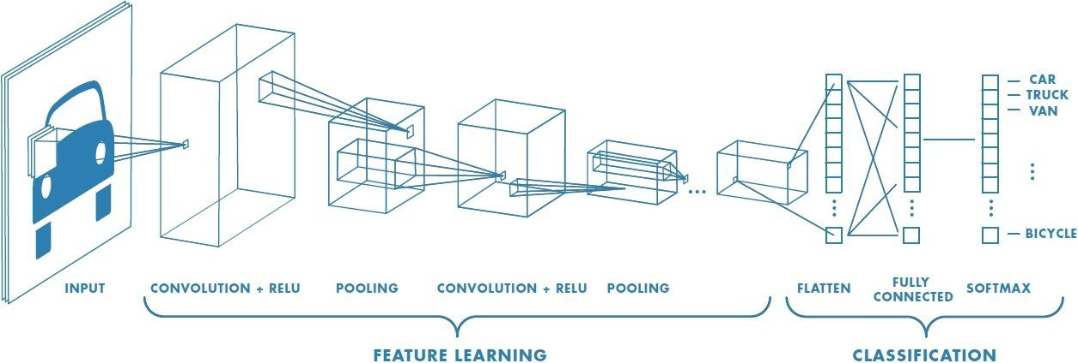
Sample Architecture

Slide 7
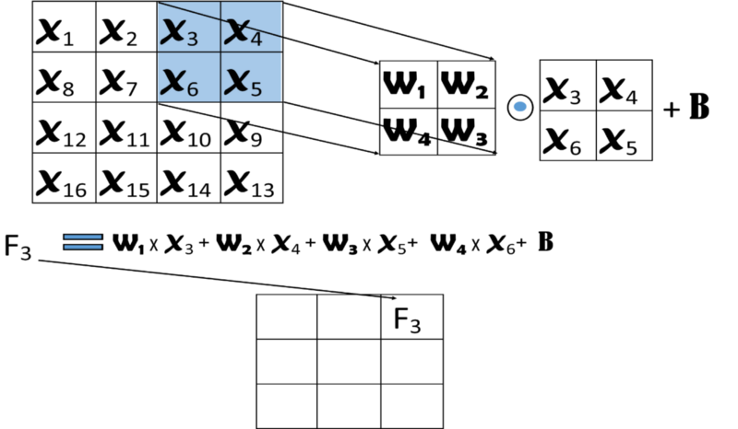
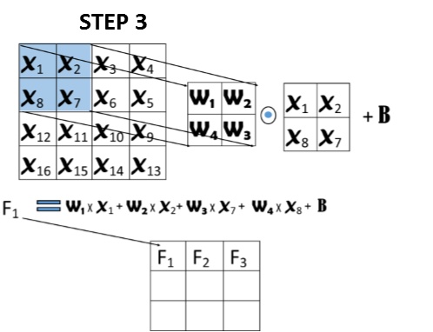
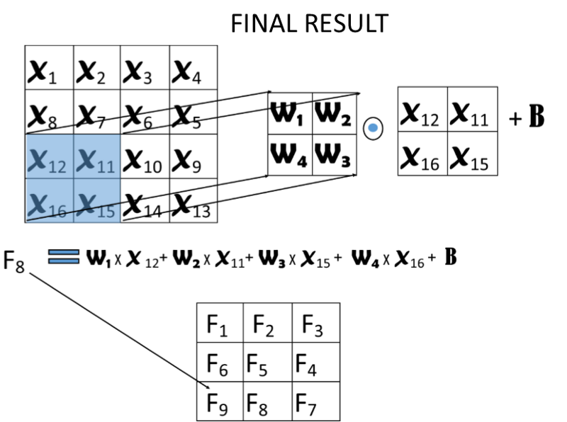
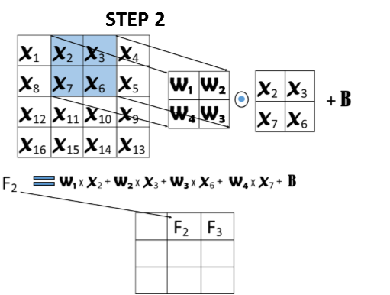
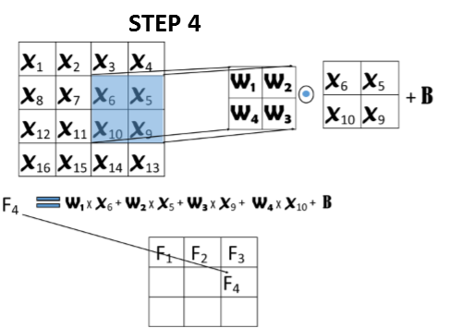
How it works? (Convolution)

Slide 8
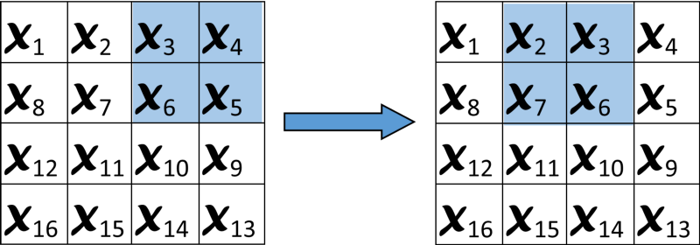
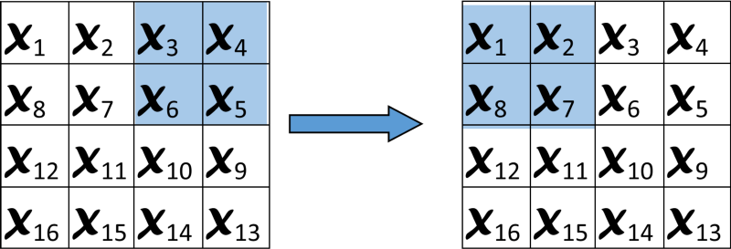
How it works? (Stride)
Stride = 1
Stride = 2

Slide 9
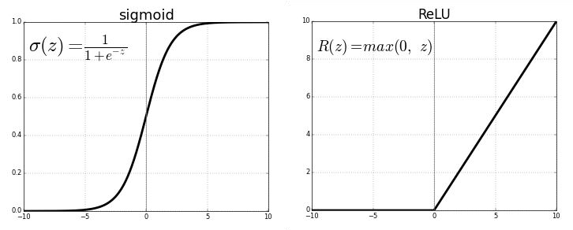
Activation Layer
Used to increase non-linearity of the
network without affecting receptive fields of conv layers
Prefer ReLU, results in faster training
LeakyReLU addresses the vanishing gradient problem
Other types:
Leaky ReLU, Randomized Leaky ReLU, Parameterized ReLU Exponential Linear Units (ELU), Scaled Exponential Linear Units Tanh, hardtanh, softtanh, softsign, softmax, softplus...

Slide 10
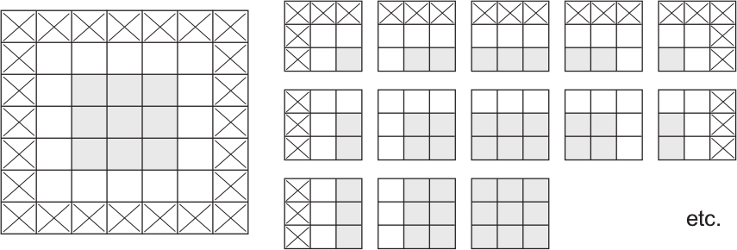
Padding
This is known as “valid” padding mode (default)
An alternative pads the input map with zeros to
yield a same-sized map

Slide 11
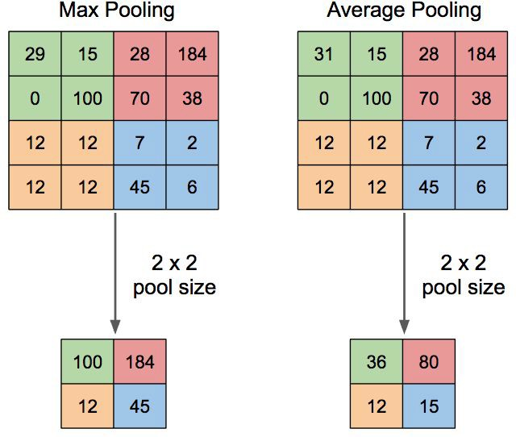
Pooling Layer
Convolutional layers provide activation maps.
Pooling layer applies
non-linear downsampling on activation maps.
Pooling is aggressive (discard info); the trend is to use smaller filter size and abandon pooling

Slide 12

Introduction to TensorFlow

Slide 13

Plan
Why TensorFlow
Basic Code Structure
Variable and Name Scopes
Disclaimer I’m not a TF expert, just passing on knowledge I have

Slide 14
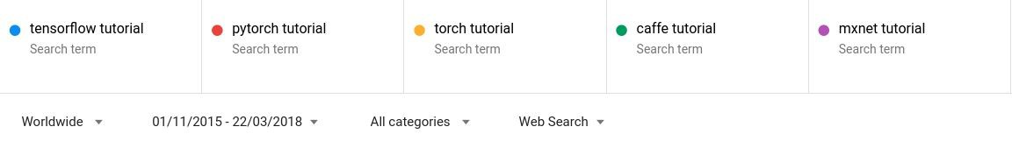
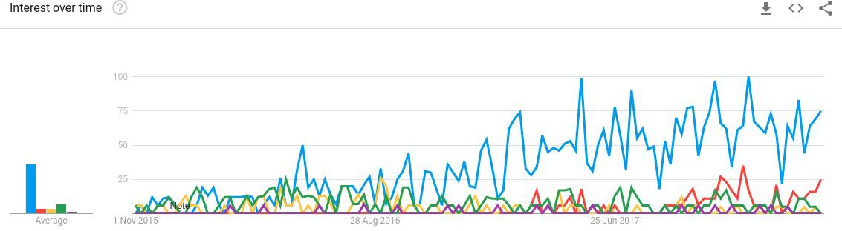
Why TensorFlow
“TensorFlow™ is an open source software library for numerical computation using data flow graphs.”
One of many frameworks for deep learning computations
Scalable and flexible
Popular (= big community)

Slide 15
Basic Code Structure
View functions as computational graphs
First build a computational graph, and then use a session to execute operations in the graph
This is the basic approach, there is also a dynamic approach implemented in the recently introduced eager mode
why graphs?

Slide 16
Basic Code Structure - Graphs
Nodes are operators (ops), variables, and constants
Edges are tensors
0-d is a scalar
1-d is a vector
2-d is a matrix
Etc.
9
TensorFlow = Tensor + Flow = Data + Flow
Add
4
a
5
b

Slide 17

Basic Code Structure - Graphs
Constants are fixed value tensors - not trainable
Variables are tensors initialized in a session - trainable
Placeholders are tensors of values that are unknown during the graph construction, but passed as input during a session
Ops are functions on tensors

Slide 18
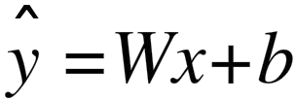
Basic Code Structure - Graphs
Add
Mul
b
variable
variable ops placeholder
W
x

Slide 19
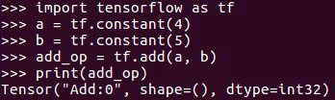
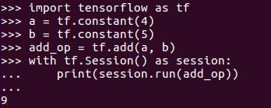
Basic Code Structure - Sessions
Session is the runtime environment of a graph, where operations are executed, and tensors are evaluated
a.eval() is equivalent to session.run(a), but in general, “eval” is limited to executions of a single op and ops that returns a value
Upon op execution, only the subgraph required for calculating its value is evaluated

Slide 20
Basic Code Structure - Sessions
Add
Mul
b
variable
variable ops placeholder
W
x

Slide 21
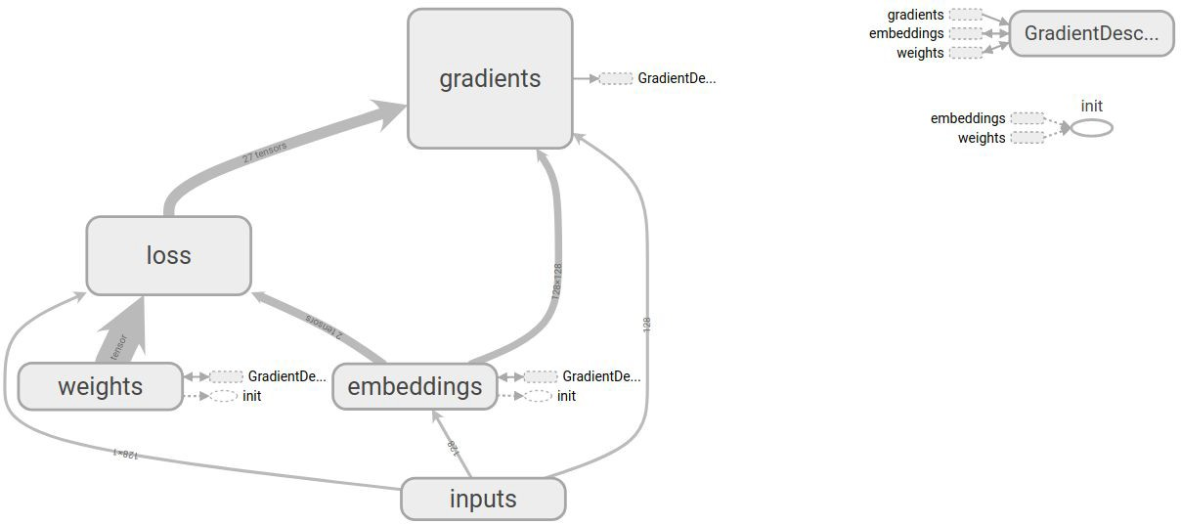
Variable and Name Scopes
Scopes allow:
Grouping of nodes in the graph
Sharing variables between graph components
This is useful as neural networks can become very complex

Slide 22
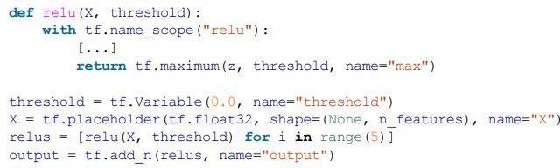
Variable and Name Scopes
tf.Variable() creates a new variable under the current scope
tf.get_variable() creates the shared variable if it does not exist yet, or reuse it if it already exists
The desired behavior is controlled by the current scope
Example from “Hands-on machine learning with Scikit-Learn and TensorFlow”

Slide 23



Variable and Name Scopes
1
2
3
Example from “Hands-on machine learning with Scikit-Learn and TensorFlow”

Slide 24
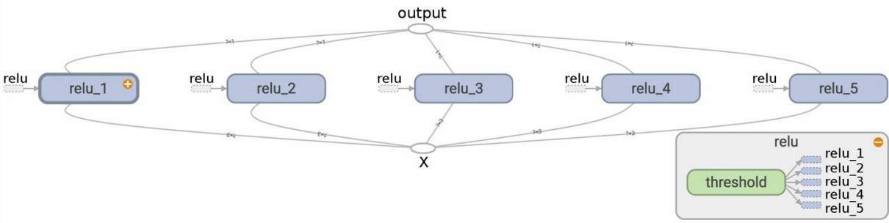
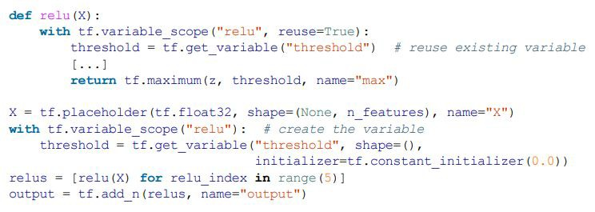
Variable and Name Scopes
Example from “Hands-on machine learning with Scikit-Learn and TensorFlow”

Slide 25
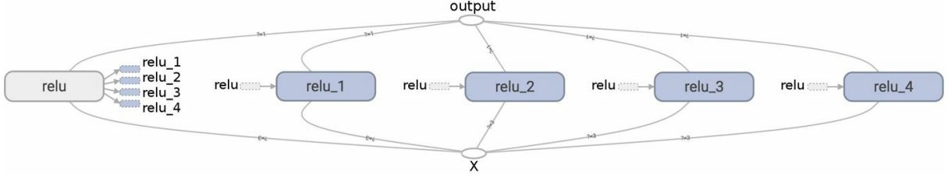
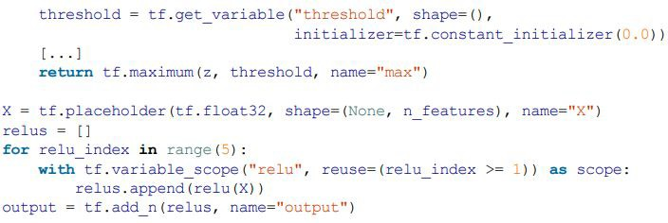
Variable and Name Scopes
tf.name_scope is ignored by tf.get_variable
Example from “Hands-on machine learning with Scikit-Learn and TensorFlow”

